Slide 1
Basic Mathematics
UNIT 3
SET THEORY

Slide 2
Set theory
Set theory is a branch of mathematical logics that studies sets which informally are collections of objects.
Objects that makes up the set are called members or elements of set
A set is denoted by capital letter , lowercase letter is used to denote elements of a set and elements of set are enclosed by flower brackets

Slide 3
To indicate particular elements belong to set we use greek notation epsilon €

Slide 4
Example
A = { a,e,i,o,u }
Where
A is name of set
a,e,i,o,u are elements of a set elements are seperated by commas
u is the member of set A it can be denoted by u € A

Slide 5
Operations on Set
Union of sets
Intersection of the sets
Disjoint sets
Set Difference

Slide 6
Union of sets
Union of the sets A and B, denoted A ∪ B, is the set of all objects that are a member of A, or B, or both.
Let A={1,2,3} and B={2,3,4}
The union of set A and set B is the set {1, 2, 3, 4}

Slide 7
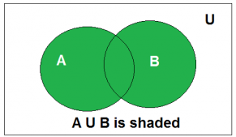
Venn Diagram of A U B

Slide 8
The intersection of the sets A and B, denoted by A ∩ B, is the set of elements belongs to both A and B
i.e. set of the common element in A and B
Let A = {2, 3, 4} and B = {3, 4, 5}
A ∩ B = {3, 4}

Slide 9
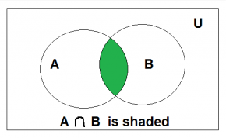
Venn Diagram of A ∩ B

Slide 10
Disjoint Two sets are said to be disjoint if their intersection is the empty set
sets have no common elements.

Slide 11
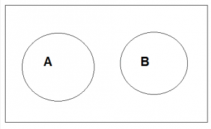
Venn Diagram of A disjoint B

Slide 12
Set Difference Difference between sets is denoted by ‘A – B’,
That is the set containing elements of set A but not in B.
all elements of A except the element of B.

Slide 13
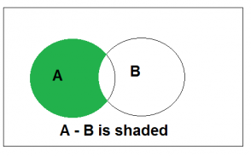
Venn Diagram of A-B

